Slide 1
Time-series Air-Quality Index Analysis
Nihar Patel
Krutin Rathod
Sanika Mhadgut
Under the Guidance of Prof. Sucheng Yu
CPE 695 : Applied Machine Learning

Slide 2



Group Members
Nihar Patel
1st Year MS Data Science Student
Krutin Rathod
1st Year MS Computer Science Student
Sanika Mhadgut
1st Year MS Computer Science Student

Slide 3
Agenda
Introduction
Problem Statement
Objective
Our Approach
Results
Future Work
References

Slide 4
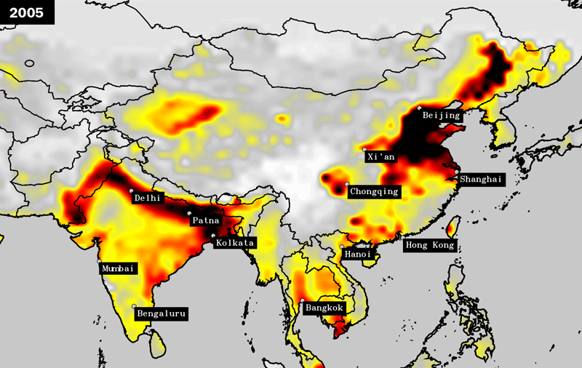
Introduction
In January 2013, a suffocating, poisonous haze hung over Beijing for four days. The record high levels of fine particulate matter in the air caused airports to close and thousands of coughing, choking citizens to seek hospital care.
Beijing’s coal-burning power plants and 5 million motor vehicles are responsible for much of the city’s pollution.
The emission of pollutants and still air that allows the pollutants to build.
Pollution timelapse of Beijing, China
https://www.weforum.org/agenda/2016/02/which-country-has-the-worst-air-pollution/
https://news.northwestern.edu/stories/2019/04/human-caused-climate-change-played-limited-role-in-beijings-2013-airpocalypse/

Slide 5
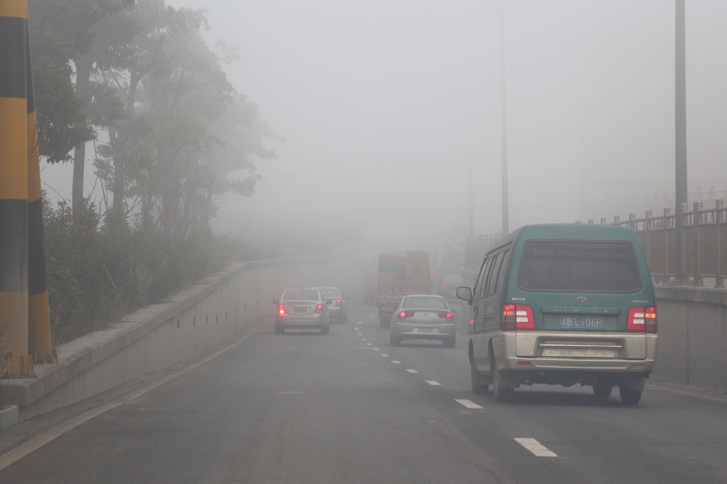
Problem Statement
The air pollution crisis in Beijing, China, during 2013 has raised significant concerns regarding public health and environmental sustainability. The city experienced severe episodes of air pollution characterized by high levels of particulate matter (PM2.5) and other pollutants, leading to adverse health effects and disruptions to daily life.
In response to this crisis, there is a need to conduct a comprehensive time-series analysis to understand the temporal patterns and trends of air pollution levels, identify key factors influencing air quality, and develop predictive models for forecasting future pollution levels.
https://upload.wikimedia.org/wikipedia/commons/thumb/9/97/Air_Contamination_in_Ningbo%2C_2013-12-07_02.jpg/220px-Air_Contamination_in_Ningbo%2C_2013-12-07_02.jpg

Slide 6
Objective
Analyze the temporal dynamics of air pollution in Beijing during the year 2013 and develop predictive models to forecast pollutant concentrations:
Exploration Data Analysis: Explore the temporal patterns and trends of air pollution levels, including PM2.5, and other relevant pollutants, using historical data from 2013 to 2017.
Factor Identification: Identify key factors influencing air quality, including meteorological variables, industrial activities, vehicular emissions, and other environmental factors.
Model Development: Develop time-series forecasting models, such as Autoregressive Integrated Moving Average (ARIMA), Seasonal Auto-Regressive Integrated Moving Average (SARIMA), FB Prophet, Vector Auto Regressor (VAR), and machine learning approaches (e.g., neural networks), to predict future air pollution levels.
Model Evaluation: Evaluate the performance of the forecasting models using appropriate metrics, such as Mean Absolute Error (MAE), Mean Squared Error (MSE), and Root Mean Squared Error (RMSE).
https://en.wikipedia.org/wiki/2013_Eastern_China_smog#/media/File:Air_Contamination_in_Ningbo,_2013-12-07_02.jpg

Slide 7
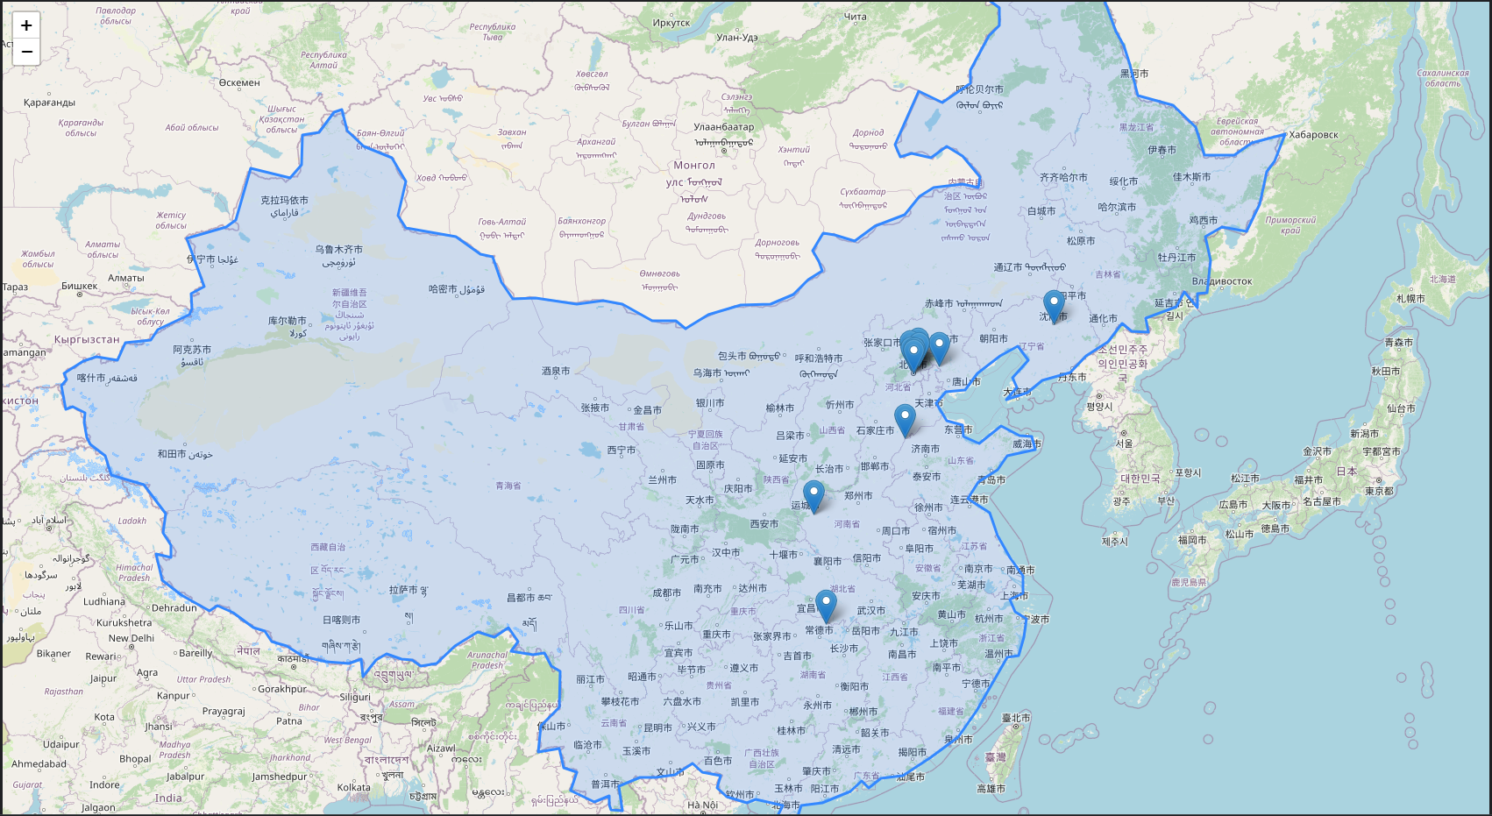
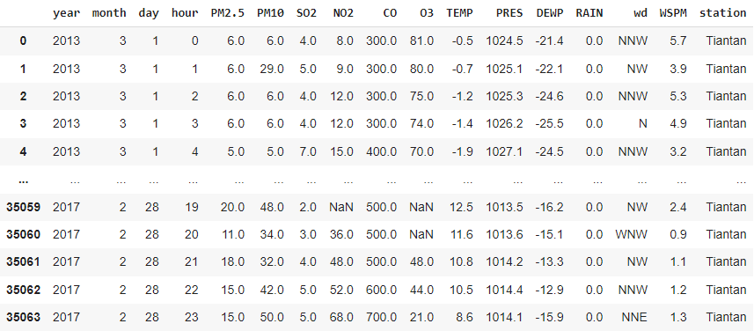
Results Dataset Overview
The dataset consists of hourly atmospheric measurements from 12 cities in Beijing, covering the period from March 1st, 2013, to February 28th, 2017.
It includes target variables such as PM2.5, PM10, SO2, NO2, CO, and O3, along with independent variables like temperature, pressure, dew point temperature, rainfall, wind speed, and wind direction.
City location of the Data Acquisition City
Raw Data as a Data Frame from City Tiantan

Slide 8
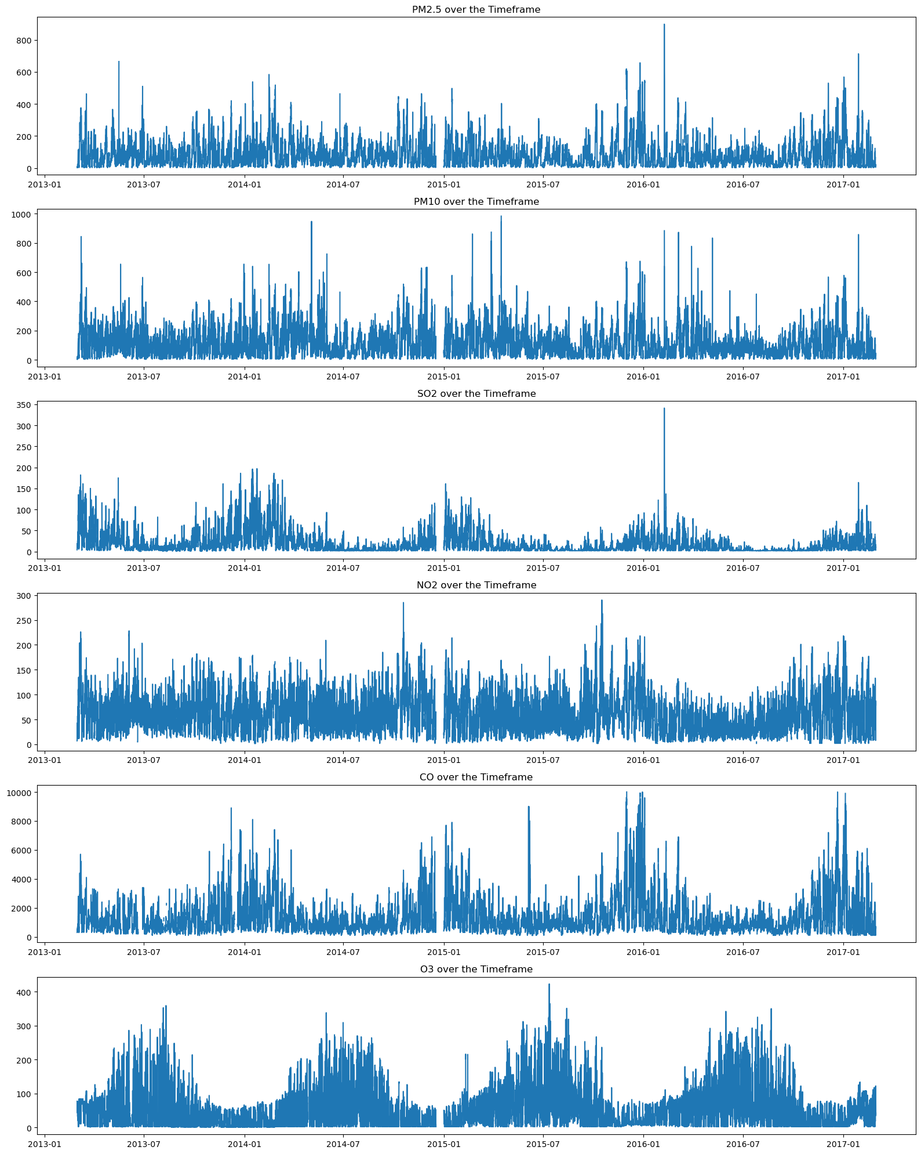
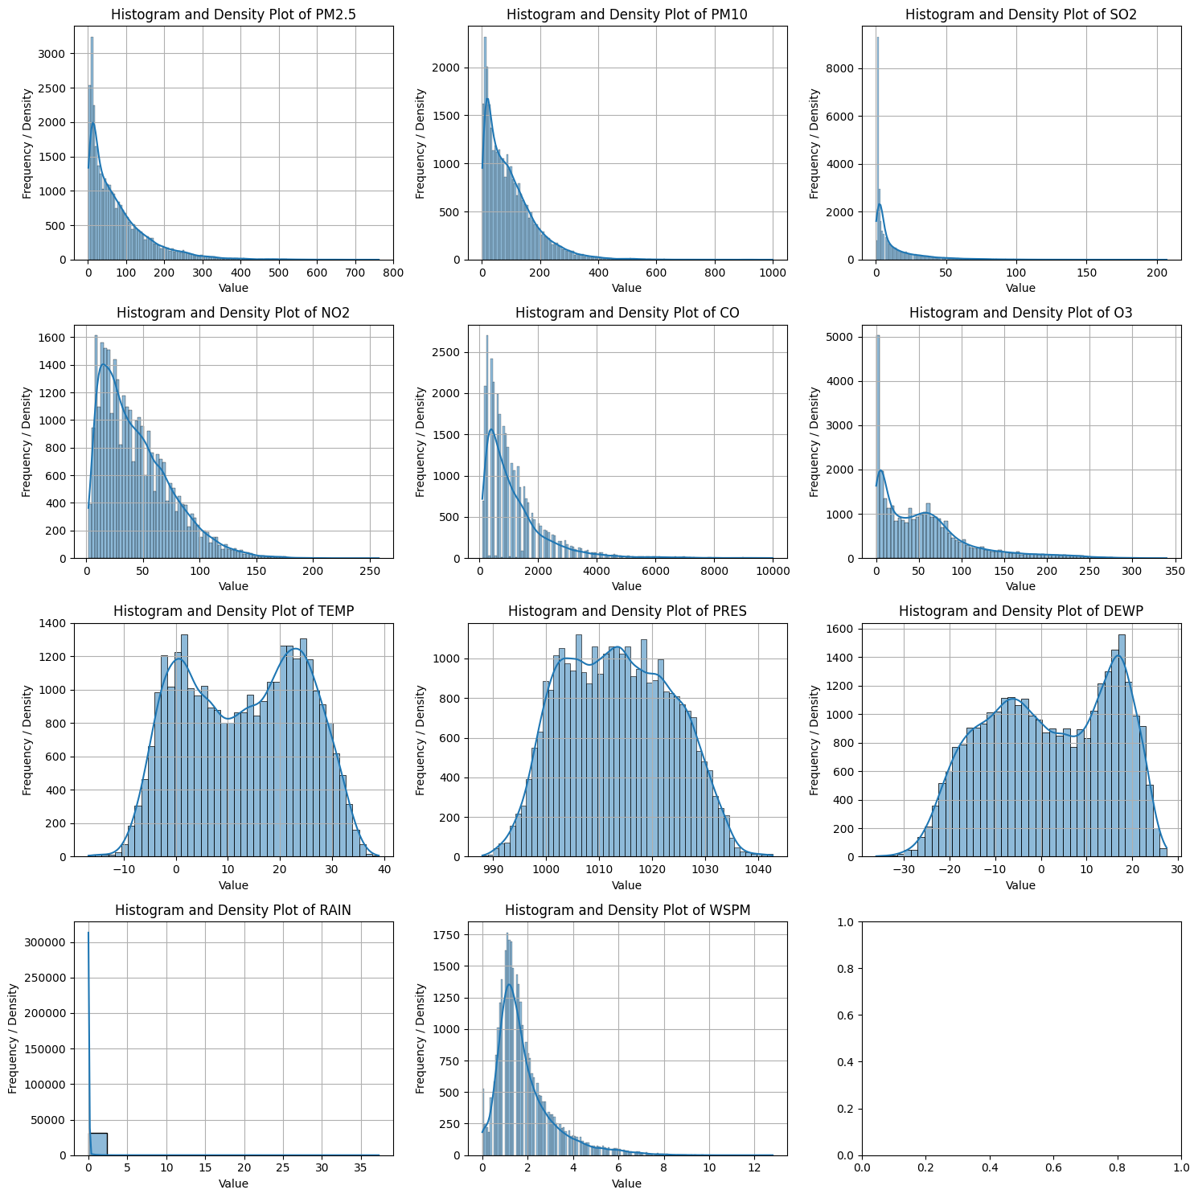
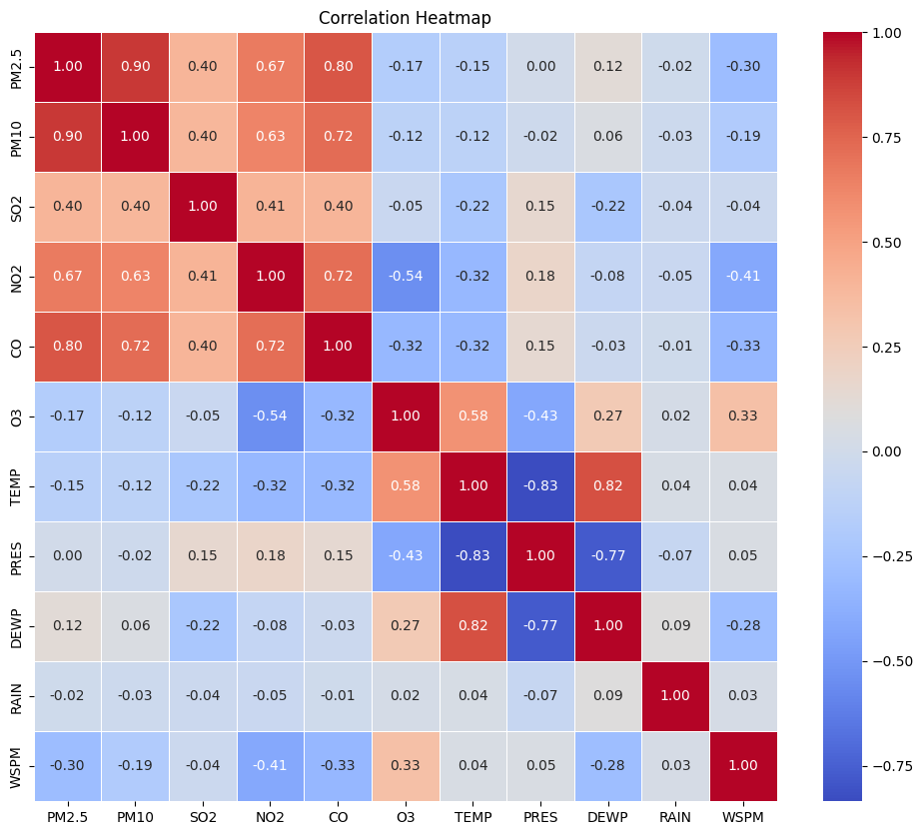
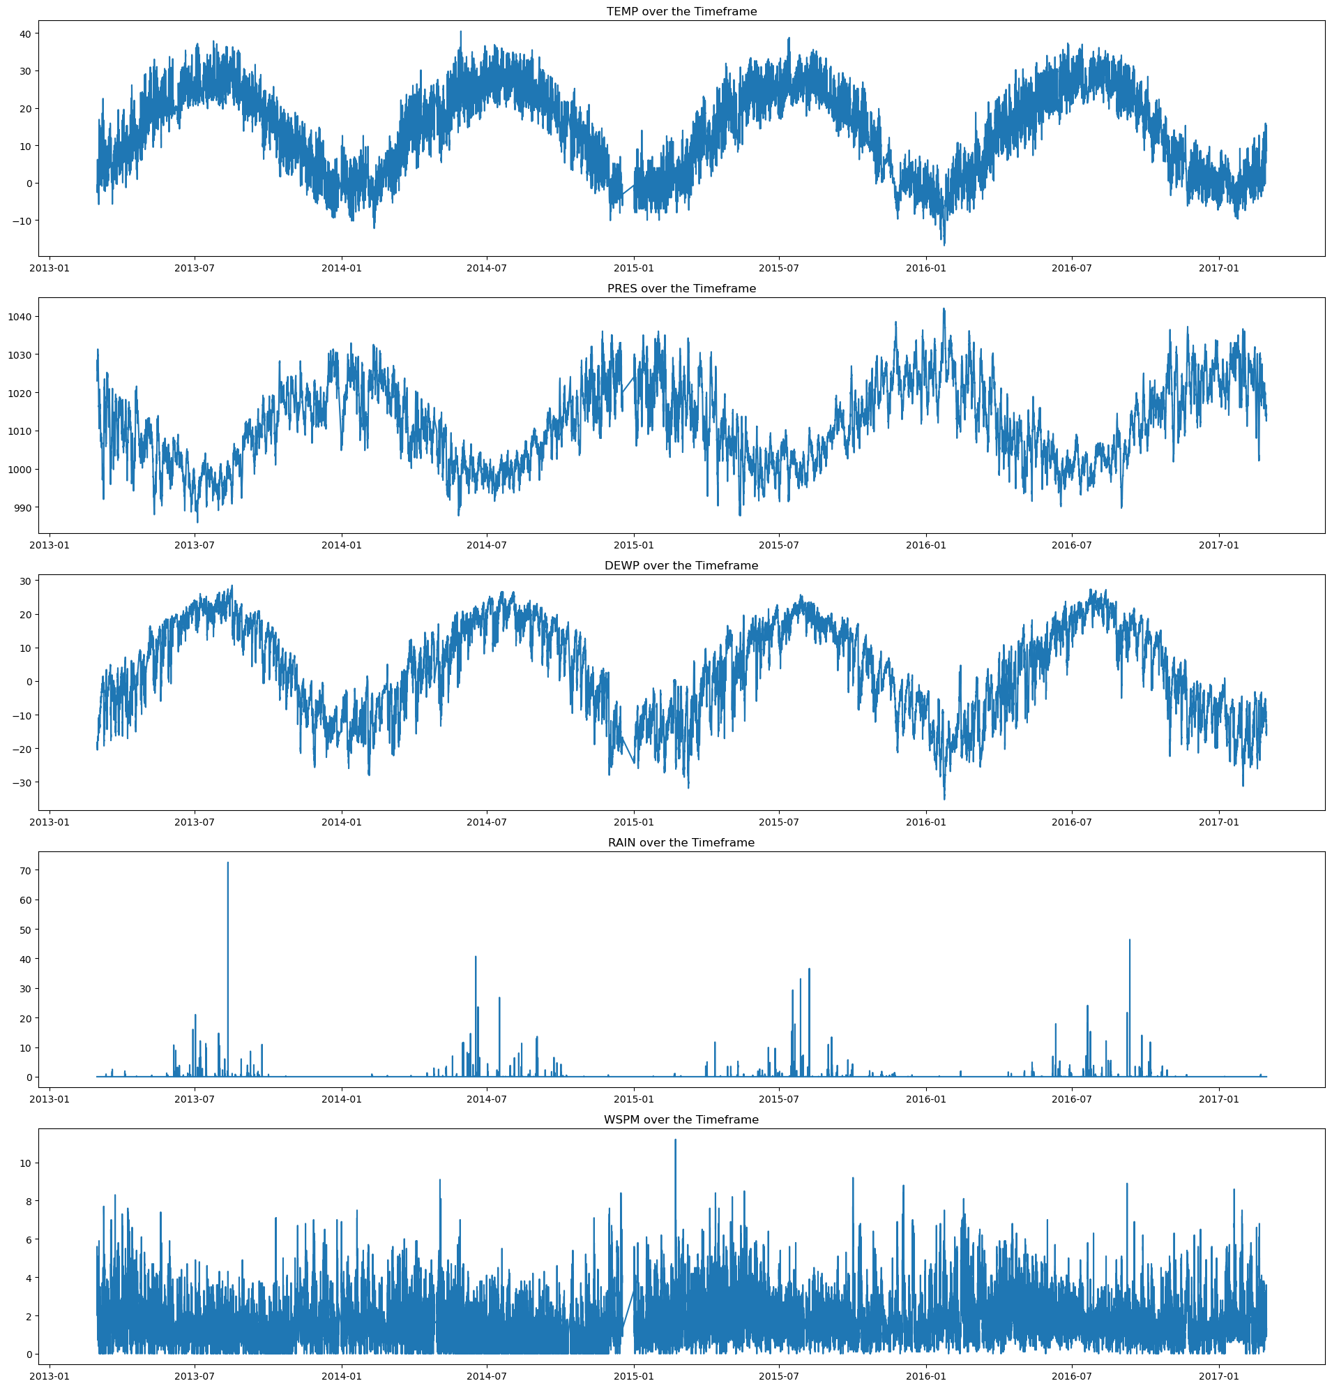
Results Exploratory Data Analysis
PM2.5
PM10
SO2
NO2
CO
O3
TEMP
PRES
DEWP
RAIN
WSPM
Raw Data
Histogram Plot
Correlation Matrix

Slide 9
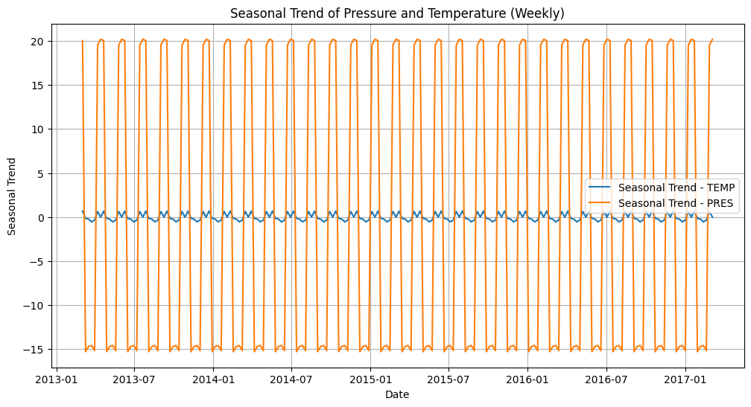
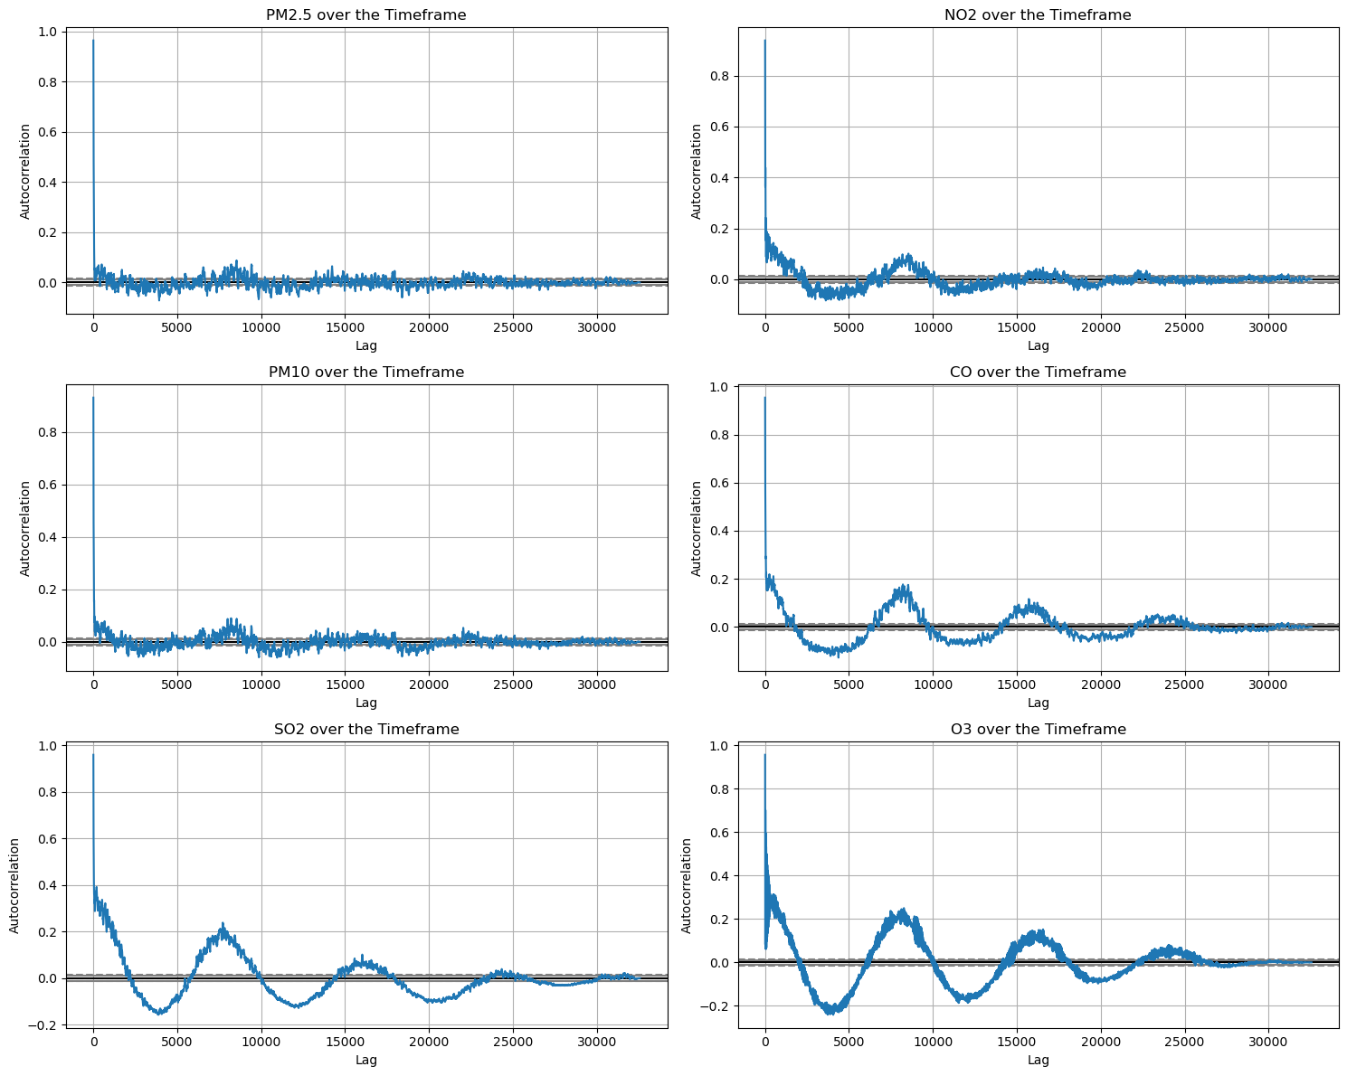
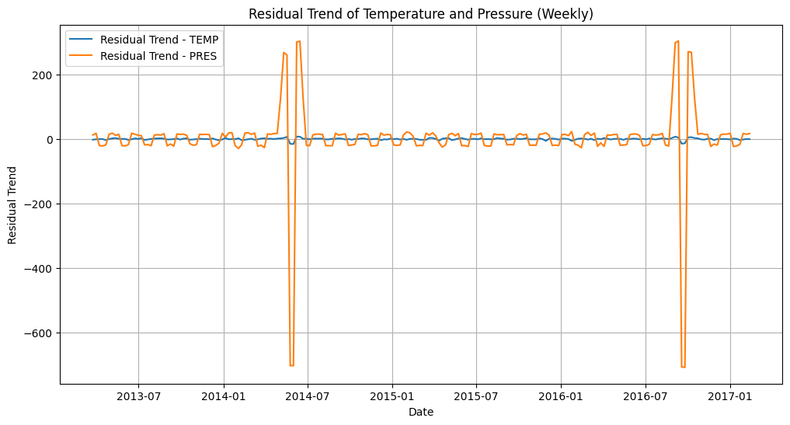
Results Exploratory Data Analysis
Seasonal Trend of Pressure and Temperature
Auto-correlation
Residual of Pressure and Temperature

Slide 10
Results
UNI-VARIATE FORECASTING MODELS

Slide 11
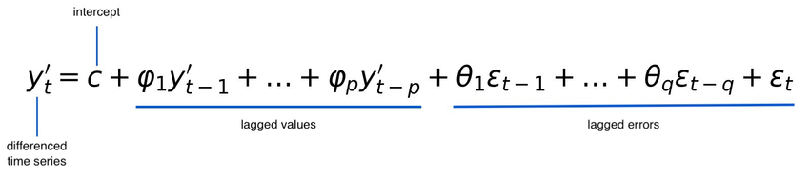
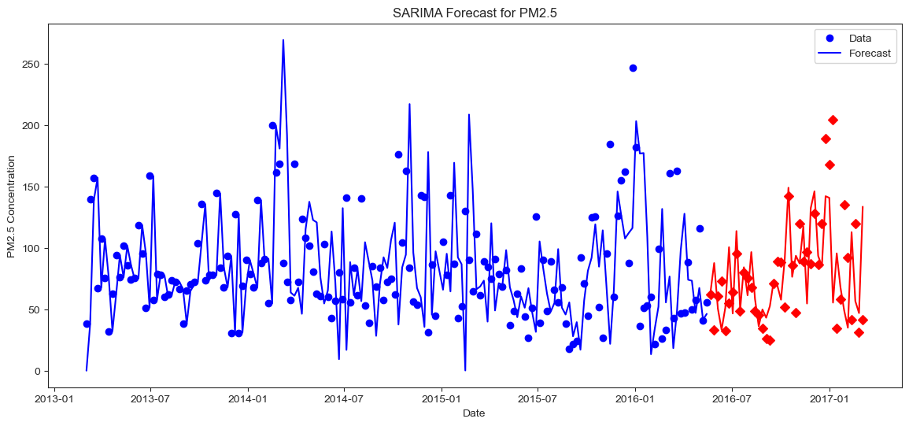
Results ARIMA & SARIMA Model
pyramid-arima
PM2.5
Performing stepwise search to minimize aic
ARIMA(0,1,0)(0,1,0)[52] : AIC=1318.303, Time=0.19 sec
ARIMA(1,1,0)(1,1,0)[52] : AIC=1281.508, Time=1.38 sec
ARIMA(0,1,1)(0,1,1)[52] : AIC=inf, Time=3.38 sec
ARIMA(1,1,0)(0,1,0)[52] : AIC=1292.152, Time=0.25 sec
ARIMA(1,1,0)(2,1,0)[52] : AIC=inf, Time=6.22 sec
ARIMA(1,1,0)(1,1,1)[52] : AIC=inf, Time=7.00 sec
ARIMA(1,1,0)(0,1,1)[52] : AIC=inf, Time=2.23 sec
ARIMA(1,1,0)(2,1,1)[52] : AIC=inf, Time=8.38 sec
ARIMA(0,1,0)(1,1,0)[52] : AIC=1307.125, Time=1.14 sec
ARIMA(2,1,0)(1,1,0)[52] : AIC=1271.524, Time=2.06 sec
ARIMA(2,1,0)(0,1,0)[52] : AIC=1286.088, Time=0.41 sec
ARIMA(2,1,0)(2,1,0)[52] : AIC=inf, Time=8.35 sec
ARIMA(2,1,0)(1,1,1)[52] : AIC=inf, Time=9.31 sec
ARIMA(2,1,0)(0,1,1)[52] : AIC=inf, Time=6.76 sec
ARIMA(2,1,0)(2,1,1)[52] : AIC=1274.336, Time=10.71 sec
ARIMA(2,1,1)(1,1,0)[52] : AIC=inf, Time=8.92 sec
ARIMA(1,1,1)(1,1,0)[52] : AIC=inf, Time=4.99 sec
ARIMA(2,1,0)(1,1,0)[52] intercept : AIC=1273.518, Time=4.87 sec

Slide 12
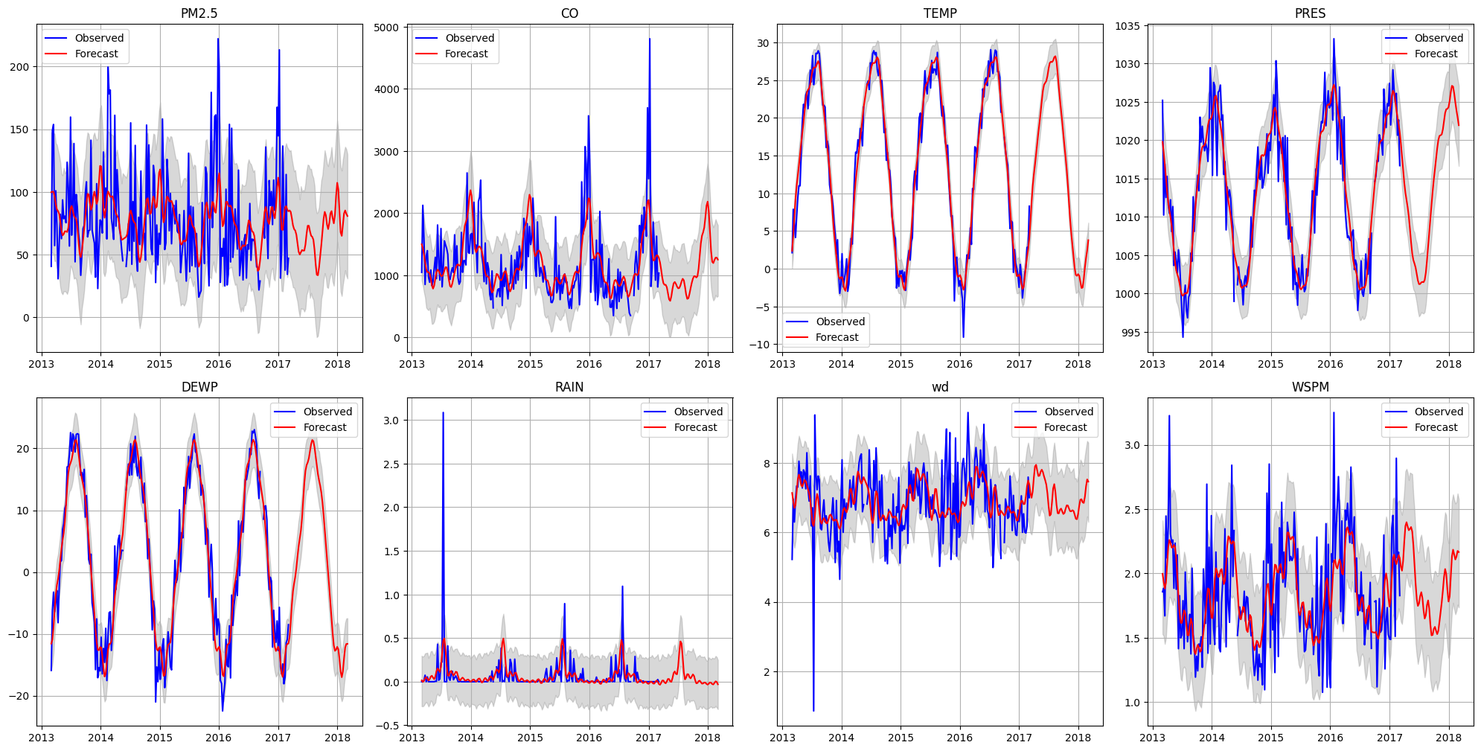
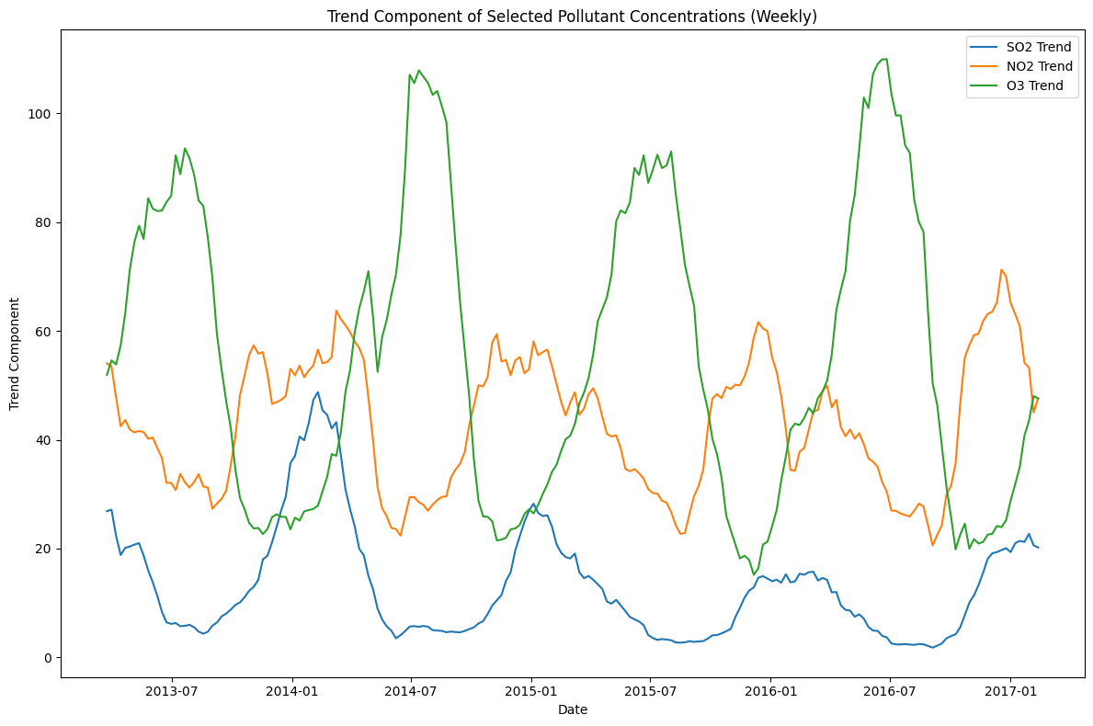
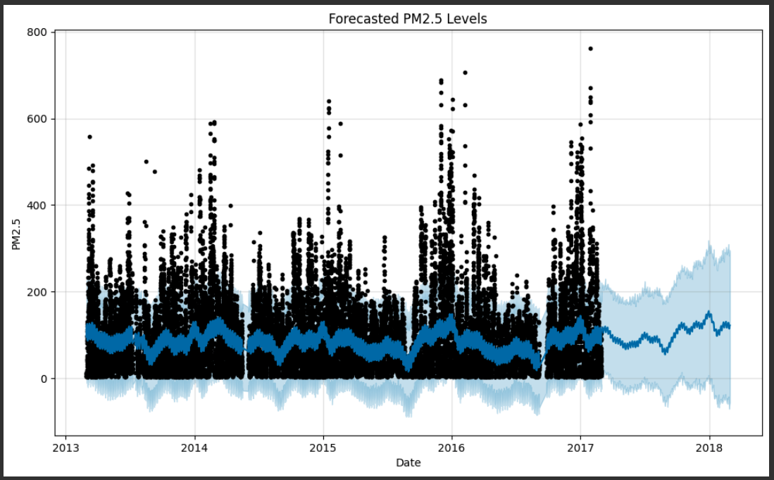
Results Prophet Model

Slide 13
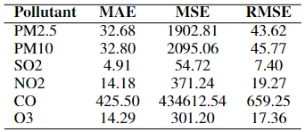
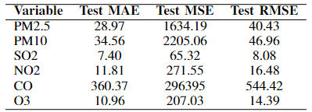
Results
UNI-VARIATE FORECASTING MODELS
SARIMA
Prophet

Slide 14
Results
MULTI-VARIATE FORECASTING MODELS

Slide 15
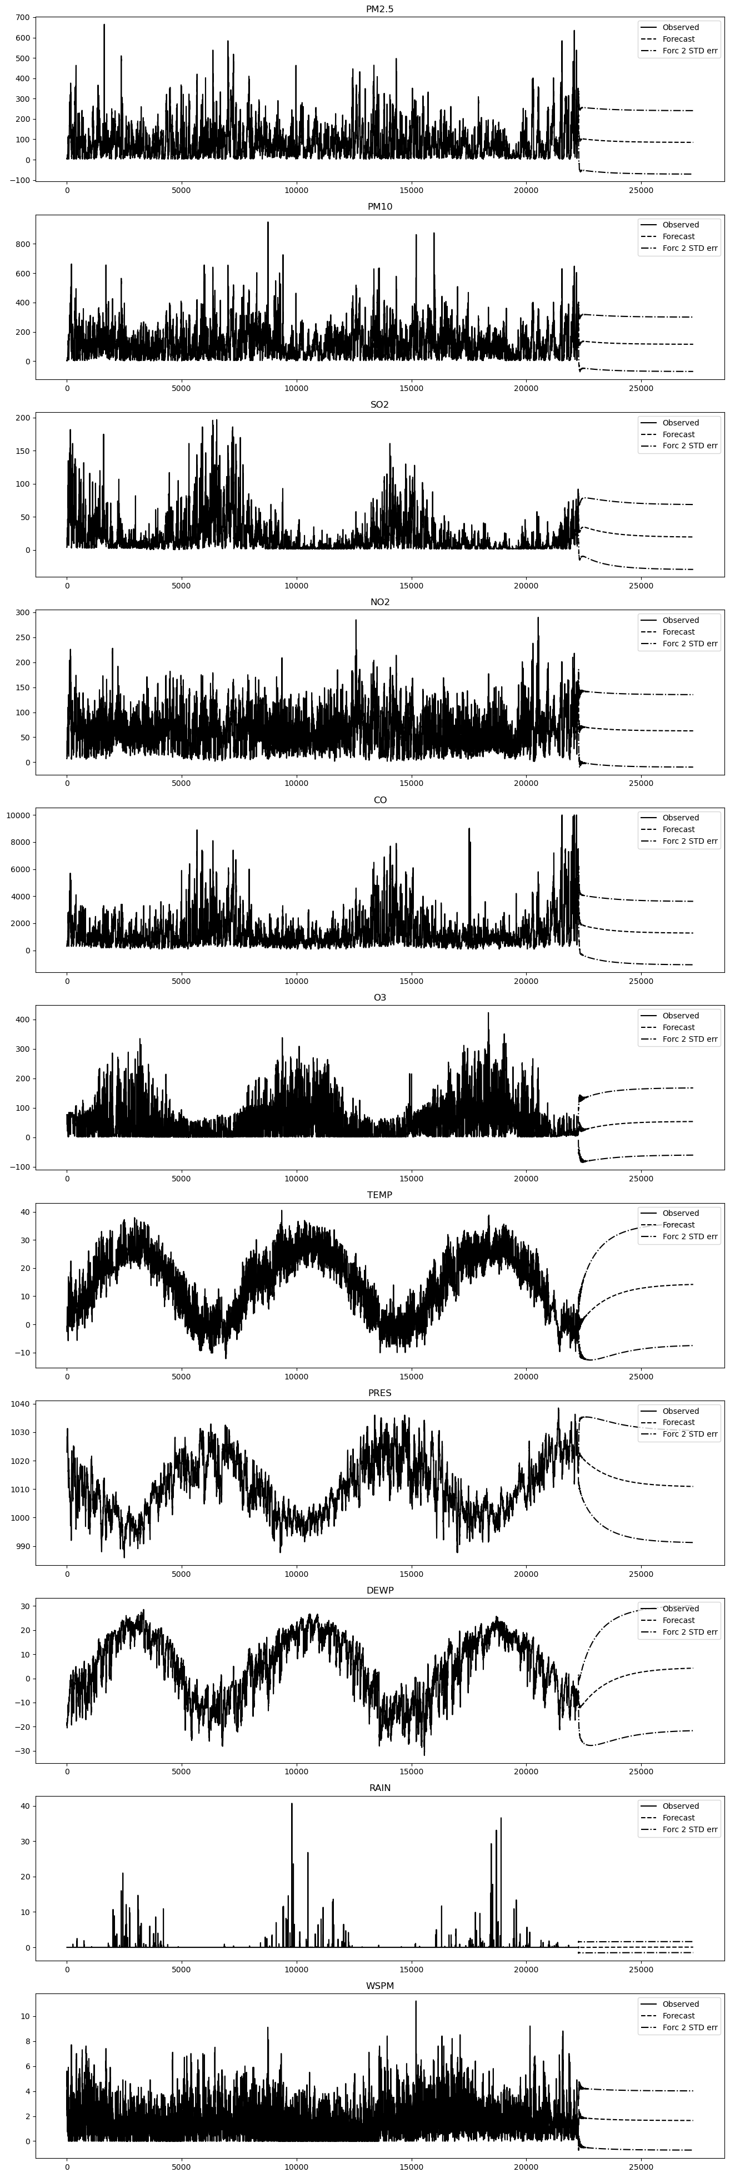
Results Vector Auto Regressor (VAR)
PM2.5
PM10
SO2
NO2
CO
O3
TEMP
PRES
DEWP
RAIN
WSPM
Vector Auto Regression Forecast Results
VAR

Slide 16
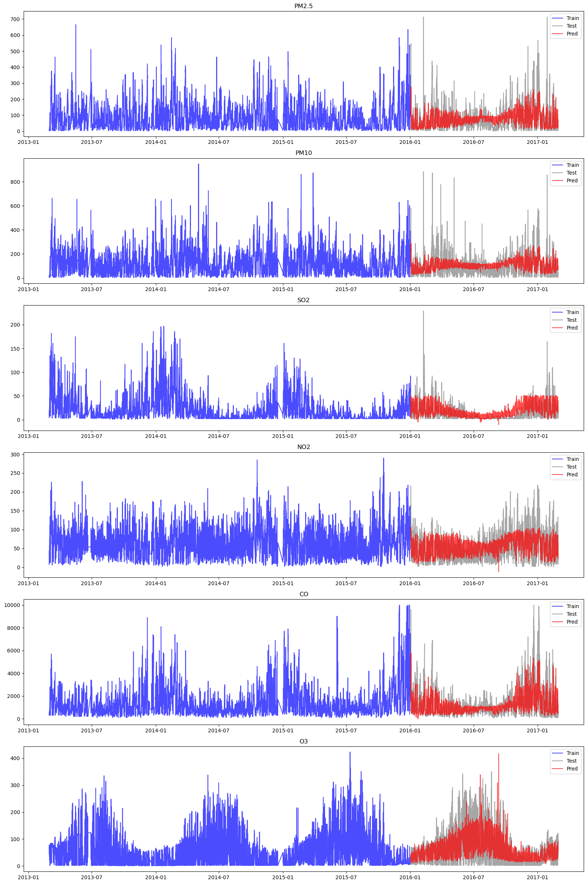
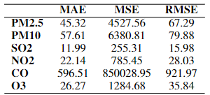
Results Multi-Layer Perceptron
PM2.5
PM10
SO2
NO2
CO
O3
PM2.5
PM10
SO2
NO2
CO
O3
TEMP
PRES
DEWP
RAIN
WSPM
550
500
200
150
50
5
6
Input
Output
Vector Auto Regression Forecast Results
Multi-Layer Perceptron Forecast Results
Hidden Layer (550 X 500 X 200 X 150 X 50)

Slide 17
Future Works
Prophet model and other Uni-variate models can be used in the pipeline to use it with categorical columns.
Vector Auto Regressor can be improved and hyper-tuned to forecast more accurately, and to mitigate variance.
RNN and LSTM can be used as models to learn and take advantage of deep learning models and their capacity to learn complex patterns.

Slide 18
References
Y. Tian, Y. Jiang, Q. Liu, D. Xu, S. Zhao, L. He, H. Liu, and H. Xu, “Temporal and spatial trends in air quality in beijing,” Landscape and Urban Planning, vol. 185, p. 35–43, May 2019.
L. Zhao, Z. Li, and L. Qu, “Forecasting of beijing pm2.5 with a hybrid arima model based on integrated aic and improved gs fixed-order methods and seasonal decomposition,” Heliyon, vol. 8, no. 12, Dec 2022.
T. Smith, “Autocorrelation: What it is, how it works, tests.” [Online]. Available: https://www.investopedia.com/terms/a/autocorrelation.asp#:∼:text=Autocorrelation%20represents%20the%20degree%20of,value%20and%20its%20past%20values.

Slide 19
Video Recording
https://stevens.zoom.us/rec/play/0AHw-5sNNNIrwCjWJDs-cuhX1jqFCPCVG-0to-i7Vhlf4ywKF_MlYIb83MxWzcikihD-62fpjRnSUV8.Y6pzRjyai4e5vV5n?canPlayFromShare=true&from=share_recording_detail&continueMode=true&componentName=rec-play&originRequestUrl=https%3A%2F%2Fstevens.zoom.us%2Frec%2Fshare%2FySQ16v0JYWB_Kh3l9JAICTbohhbAVHx6eyol0Zl5IedaJYd2ZZJYxsfWFACg38Uy.IWNMDETKwV-vrWi6&autoplay=true&startTime=1715300805000

